Slide 1
Introduction to Programming
Intro to Python Week 3

Slide 2
Lists

Slide 3
Lists
A list is an object that holds a collection of objects; it represents a sequence of data. In that sense, a list is similar to a string, except a string can hold only characters.
A list can hold any Python object. A list need not be homogeneous; that is, the elements of a list do not all have to be of the same type.

Slide 4

Ordering

Slide 5
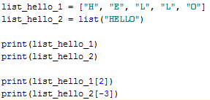
List Ordering

Slide 6

List Slicing
Retrieving a subset of items
What are the outputs of

Slide 7
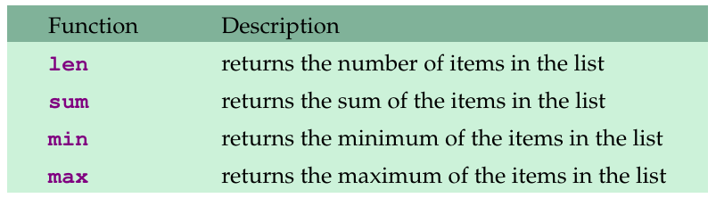
Functions and Methods for Lists
There are several built-in functions that operate on lists. Here are some useful ones:
For example, the following computes the average of the values in a list L:
average = sum(L)/len(L)

Slide 8
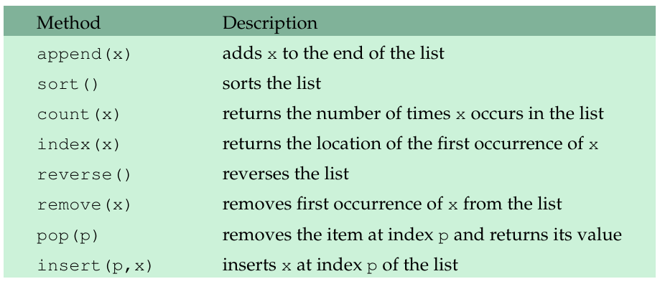
Functions and Methods for Lists
Here are some list methods:

Slide 9
Adding Items
Need to use method
List.Append( new_item )
List.Insert(Index_Position, new_item)
Does not needs to be next in sequence
Updating values
List[ index ] = new_value

Slide 10
Searching Items
for item_to_search IN list_values
List.index(item_to_search)
ValueError if not found
List.count(item_to_search)
Occurences of item in list

Slide 11
Concatenation / Multiplier
List.extend(other_list)
Adds other_list to end of of List
+=
Same as above
List_Values * num_of_times_to_repear

Slide 12
Removal
List.remove(item_to_remove)
Raises ValueError
List.pop( [index] )
del keyword
Clear() method

Slide 13
Sorting
List.sort()
Key, reverse
Sorted( any_iterable)
Key, reverse
Difference
changes current vs returns new

Slide 14
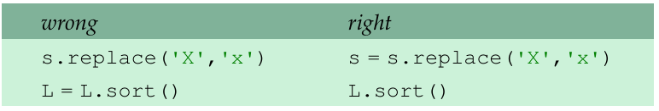
Functions and Methods for Lists
Important note There is a big difference between list methods and string methods: String methods do not change the original string, but list methods do change the original list.
To sort a list L, just use L.sort() and not L=L.sort(). In fact, the latter will not work at all.

Slide 15
Tuples

Slide 16
Tuples
A tuple is essentially an immutable list. Below is a list with three elements and a tuple with three elements:
Tuples are enclosed in parentheses, though the parentheses are actually optional.
Indexing and slicing work the same as with lists.
As with lists, you can get the length of the tuple by using the len function, and, like lists, tuples have count and index methods.
However, since a tuple is immutable, it does not have any of the other methods that lists have, like sort or reverse, as those change the list.
L = [1,2,3]
t = (1,2,3)

Slide 17
Tuples
One reason why there are both lists and tuples is that in situations where speed really matters, tuples are generally faster than lists.
The flexibility of lists comes with a corresponding cost in speed.
To convert an object into a tuple, use tuple.
The following example converts a list and a string into tuples:
t1 = tuple([1,2,3])
t2 = tuple('abcde')

Slide 18
Packing / Unpacking Tuples
To extract values of tuples
Variable, after variable = tuple( first_item, item2 )
* unpacks tuple to function arguments
Create functions that return tuples

Slide 19
Sets

Slide 20
Sets, as in Mathematical Sets
in mathematics, a set is a collection of objects, potentially of many different types
in a set, no two elements are identical. That is, a set consists of elements each of which is unique compared to the other elements
there is no order to the elements of a set
a set with no elements is the empty set

Slide 21
Creating a set
Set can be created in one of two ways:
constructor: set(iterable) where the argument is iterable
my_set = set('abc')
my_set → {'a', 'b', 'c'}
shortcut: {}, braces where the elements have no colons (to distinguish them from dicts)
my_set = {'a', 'b','c'}

Slide 22
Diverse elements
A set can consist of a mixture of different types of elements
my_set = {'a',1,3.14159,True}
as long as the single argument can be iterated through, you can make a set of it

Slide 23
no duplicates
duplicates are automatically removed
my_set = set("aabbccdd")
print(my_set)
→ {'a', 'c', 'b', 'd'}

Slide 24
common operators
Most data structures respond to these:
len(my_set)
the number of elements in a set
element in my_set
boolean indicating whether element is in the set
for element in my_set:
iterate through the elements in my_set

Slide 25
Set operators
The set data structure provides some special operators that correspond to the operators you learned in middle school.
These are various combinations of set contents
These operations have both a method name and a shortcut binary operator

Slide 26
method: intersection, op: &
a_set=set("abcd") b_set=set("cdef")
a b c d
e f
a_set & b_set → {'c', 'd'}
b_set.intersection(a_set) → {'c', 'd'}

Slide 27
method:difference op: -
a_set=set("abcd") b_set=set("cdef")
a b c d
e f
a_set – b_set → {'a', 'b'}
b_set.difference(a_set) → {'e', 'f'}

Slide 28
method: union, op: |
a_set=set("abcd") b_set=set("cdef")
a b c d e f
a_set | b_set → {'a', 'b', 'c', 'd', 'e', 'f'}
b_set.union(a_set) → {'a', 'b', 'c', 'd', 'e', 'f'}

Slide 29
method:symmetric_difference, op: ^
a_set=set("abcd"); b_set=set("cdef")
a b c d
e f
a_set ^ b_set → {'a', 'b', 'e', 'f'}
b_set.symmetric_difference(a_set) → {'a', 'b', 'e', 'f'}

Slide 30
method: issubset, op: <= method: issuperset, op: >=
small_set=set("abc"); big_set=set("abcdef")
a b c d e f
small_set <= big_set → True
bit_set >= small_set → True

Slide 31
Other Set Ops
my_set.add("g")
adds to the set, no effect if item is in set already
my_set.clear()
emptys the set
my_set.remove("g") versus my_set.discard("g")
remove throws an error if "g" isn't there. discard doesn't care. Both remove "g" from the set
my_set.copy()
returns a shallow copy of my_set

Slide 32
Dictionaries

Slide 33
What is a dictionary?
In data structure terms, a dictionary is better termed an associative array, associative list or a map.
You can think if it as a list of pairs, where the first element of the pair, the key, is used to retrieve the second element, the value.
We map a key to a value

Slide 34
Key Value pairs
The key acts as an index to find the associated value.
Just like a dictionary, you look up a word by its spelling to find the associated definition
A dictionary can be searched to locate the value associated with a key
Key must be immutable
strings, integers, tuples are fine
lists are NOT
Value can be anything

Slide 35
Dictionaries
To declare a dictionary we enclose it in curly braces, {}.
Each entry consists of a pair separated by a colon.
The first part of the pair is called the key and the second is the value.
The key acts like an index.
Here is a simple dictionary:
So in the first pair, 'A':100, the key is 'A', the value is 100, and d['A'] gives 100.
Keys are often strings, but they can be integers, floats, and many other things as well. You can mix different types of keys in the same dictionary and different types of values, too.
d = {'A':100, 'B':200}

Slide 36
Functions and Methods for Dictionaries
To change d['A'] to 400: d['A']=400
To add a new entry to the dictionary, we can just assign it, like below: d['C']=500
To delete an entry from a dictionary, use the del operator: del d['A']
To copy a dictionary, use its copy method. Here is an example: d2 = d.copy()
The empty dictionary is {}, which is the dictionary equivalent of [] for lists or '' for strings.
d = {'A':100, 'B':200}

Slide 37
Functions and Methods for Dictionaries
The dict function is another way to create a dictionary.
d = dict([('A',100),('B',300)])
This creates the dictionary {'A':100,'B':300}. This way of building a dictionary is useful if your program needs to construct a dictionary while it is running.

Slide 38
Dictionary content methods
my_dict.items() – all the key/value pairs
my_dict.keys() – all the keys
my_dict.values() – all the values
There return what is called a dictionary view.
the order of the views corresponds
are dynamically updated with changes

Slide 39
Views are iterable
for key in my_dict:
print key
prints all the keys
for key,value in my_dict.items():
print key,value
prints all the key/value pairs
for value in my_dict.values():
print value
prints all the values

